Slide 1
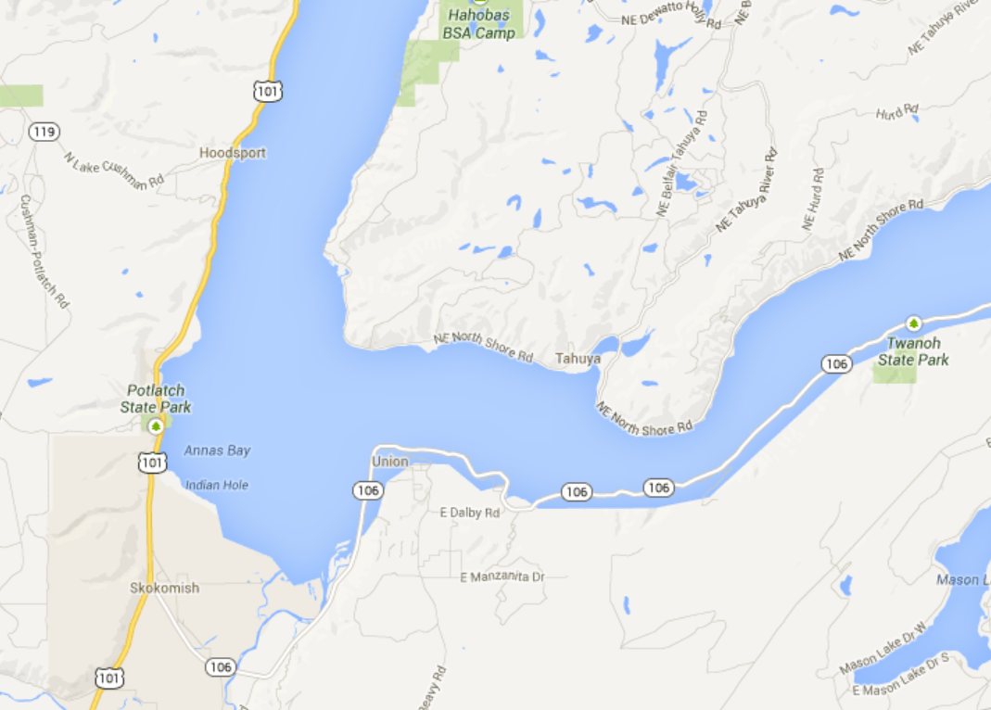
Buoy
Buoy
5 km
Bottom
Node
8 km
Marina

Slide 2
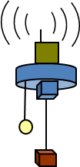
Buoy
S-S Float
Modem 2
Modem 1
Profiler
Bottom Node 3
500 m

Slide 3
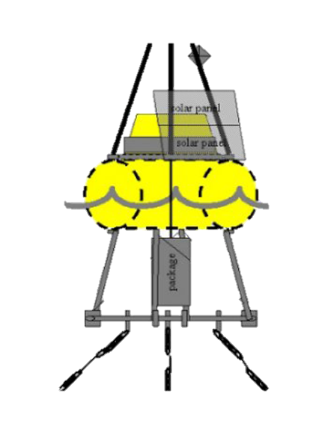
Buoy
S-S Float
Modem 2
Modem 1
Profiler
Bottom Node 3
500 m
Buoy
Buoy
5 km
Bottom
Node
8 km
Marina

