Slide 1
Transmission Investments
Daniel Kirschen

Slide 2
Functions of Transmission
Transport electric power
  Securely
  Efficiently
Minimize operating costs
  Optimize scheduling over a larger set of plants
  Take advantage of the diversity in peak loads
  Reduce the reserve requirements by pooling risks
Make possible a competitive electricity market

Slide 3
Rationale for transmission
Transmission exists only because generation and loads are in the wrong place..

Slide 4
Integrated Generation and Transmission Planning
Least cost development must consider interactions between generation and transmission
Generation
Expansion
Plan
G
Transmission
Expansion
Plan
O(G,T)
T
Operation
Analysis

Slide 5
Features of the transmission business
Capital intensive business
Small re-sale value of transmission assets
  Investments are irreversible: stranded investments
Long-lived assets
  Things change over their lifetime
Economies of scale
  Average cost decreases with capacity
Long-lead times for construction
Monopoly

Slide 6
Business models
Traditional
  Integrated development of generation and transmission
Competitive
  Generation and transmission are separated to ensure fair competition
  Regulated transmission expansion
    Monopoly, subject to regulatory approval
    Regulator “buys” transmission capacity on behalf of users
  Merchant expansion
    Treat transmission like any other business
    Unregulated companies build capacity and sell it to users

Slide 7
Cost-based transmission expansion
Transmission company proposes a new investment
  Transmission line or other form of reinforcement
Regulator approves (or rejects) the proposed investment
Transmission company builds the new expansion
Transmission company collects revenues from users to pay for the investment
Transmission company’s profit based on rate of return (small but low risk)

Slide 8
Cost-based transmission expansion
Issues:
  How much transmission expansion is needed?
  How should the cost be shared between the users?

Slide 9
How much transmission capacity?
Make projection of needs based on forecasts
  Demographics, economic growth
Lots of uncertainty
Better too much than too little
  Transmission cost is only about 10% of overall cost
  Lack of transmission has severe consequences
However, rate of return encourages companies to invest too much
Difficult to achieve economic optimum

Slide 10
How to allocate the cost of transmission?
Discuss methods that could be used to allocate the cost of transmission to users of the transmission network:
  Generators
  Consumers
Basis for allocation of cost
Advantages and disadvantages
Consider both:
  Internal users
  “Wheeling” transactions

Slide 11
Wheeling transactions
G
Network of Transmission Company
C

Slide 12
Postage stamp methods
Based on peak MW demand
  Adjustment for MWh, voltage level
Simple
Adjusted to make sure company gets enough revenue
Does not reflect distance
Reflects average cost, not usage by particular user
Does not encourage generators to locate “in the right place”
“Pancaking” of rates if transaction involves network of several transmission companies

Slide 13
Contract path method
Used when transactions were infrequent
Users and transmission company would agree on a (fictitious) contract path
Cost of transmission would be based on the cost of the transmission facilities included in that path
Appears more cost reflective but power flows know nothing about contracts

Slide 14
MW-mile methods
Use power flow calculations to trace the power through the network
Multiply the MW-miles of the power flows by an agreed rate
Would be rigorous if network were linear
Non-linear networks → choice of base case affects the overall cost

Slide 15
What is the value of transmission?
20 $/MWh
A
1000 MW
B
45 $/MWh
G₁
G₂
1000 MW
Assume
  No limit on transmission capacity
  No limit on generation capacity
  Ignore losses and security issues

Slide 16
What is the value of transmission?
20 $/MWh
A
1000 MW
B
G₁
1000 MW
Value is now based on what value consumers put on
electricity!

Slide 17
Perspective of a vertically integrated utility
20 $/MWh
A
1000 MW
B
45 $/MWh
G₁
G₂
?
2000 MW
Balance transmission capital cost and generation operating cost
  Reinforce the transmission or supply the load from more expensive local generation?

Slide 18
Perspective of a transmission merchant
Unregulated company
  No guarantee on revenue
  No limit on profit
Builds a transmission line
Collects revenue based on:
  Amount of power transmitted
  Price difference between the two ends of the line

Slide 19
Merchant interconnection
Borduria
?
Syldavia
D_{B}= 500 MW
D_{S}= 1500 MW
Should an interconnection be built between Borduria and Syldavia?
What is the demand for transmission?
What is the optimal capacity of this line ?

Slide 20
Zero transmission capacity
Borduria
Syldavia
D_{B}= 500 MW
D_{S}= 1500 MW
Each country supplies its own demand

Slide 21
Zero transmission capacity
Supply curve for Syldavia
43.0 $/MWh
Supply curve for Borduria
15.0 $/MWh
P_{B} = D_{B} = 500 MW
P_{S} = D_{S} = 1500 MW

Slide 22
Infinite transmission capacity
Borduria
Syldavia
D_{B}= 500 MW
D_{S}= 1500 MW
No limit on flows means that the two countries operate a single market

Slide 23
Infinite transmission capacity
Supply curve for Syldavia
Supply curve for Borduria
24.3 $/MWh
24.3 $/MWh
= 1433 MW
= 567 MW
= 933 MW
= 500 MW
= 1500 MW
= 2000 MW

Slide 24
Price difference as a function of capacity
Supply curve for Syldavia
Supply curve for Borduria
F_{MAX} = 0 MW
F_{MAX} = 933 MW
= 500 MW
= 1500 MW

Slide 25
Transmission demand function

Slide 26
Transmission demand function
28$/MWh
933 MW
F

Slide 27
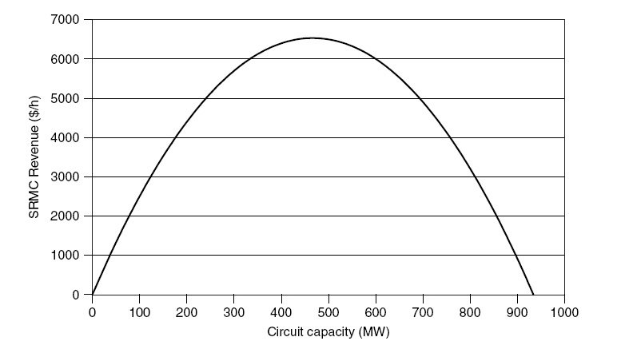
Transmission revenue

Slide 28
Transmission supply function
Cost of building a transmission line:
Marginal cost:
Hourly marginal cost:
(assumed linear for simplicity)
Capacity in MW
Length of the line in km
Annuitized cost of building 1 km of line in $/MW.km.year

Slide 29
Supply/Demand Equilibrium
($/MWh)
4
800
F (MW)
k = 35 $/year. MW. km
l = 1000 [km]

Slide 30
Supply/Demand Equilibrium
($/MWh)
Optimal
Price
Difference
4
800
F (MW)
Add transmission capacity until the marginal savings in generation cost is equal to the marginal cost of building additional transmission capacity
Optimal
Transmission
Capacity

Slide 31
Optimal transmission capacity
27 $/MWh
4 $/MWh
23 $/MWh
= 800 MW
= 500 MW
= 1500 MW

Slide 32
Total cost
Total cost
Cost of constraints
Investment cost

Slide 33
Revenue with suboptimal transmission capacity
In practice, actual transmission capacity ≠ optimal
System operated based on actual capacity
Nodal energy prices and congestion surplus are determined by the actual network
Over-investment
  Difference in prices is too low → under recovery of investment costs
Under-investment
  Difference in prices is high → over recovery of investment costs

Slide 34
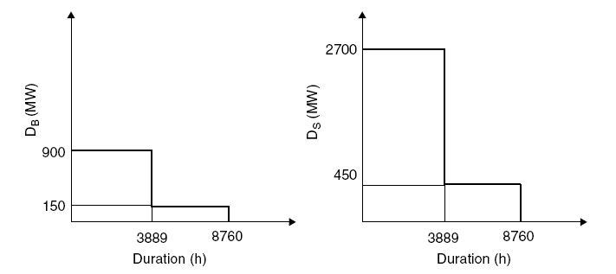
Effect of variable demand
Borduria
Syldavia
Simplified load duration curves

Slide 35
Unconstrained generation costs
During some hours the flow will be constrained by the capacity of the interconnection.
To calculate the cost of this congestion, we need to know the unconstrained generation cost for the peak- and off-peak loads
Load | Generation in Borduria | Generation in Syldavia | Total hourly generation cost
[MW] | [MW] | [MW] | [$/h]
600 | 500 | 100 | 7,650
3600 | 2500 | 1100 | 82,650

Slide 36
Off peak performance
Interconnection Capacity | Generation in Borduria | Generation in Syldavia | Total hourly generation cost | Hourly constraint cost
[MW] | [MW] | [MW] | [$/h] | [$/h]
0 | 150 | 450 | 9,488 | 1,838
100 | 250 | 350 | 8,588 | 938
200 | 350 | 250 | 7,988 | 338
300 | 450 | 150 | 7,688 | 38
350 | 500 | 100 | 7,650 | 0
400 | 500 | 100 | 7,650 | 0
450 | 500 | 100 | 7,650 | 0
500 | 500 | 100 | 7,650 | 0
600 | 500 | 100 | 7,650 | 0
700 | 500 | 100 | 7,650 | 0
800 | 500 | 100 | 7,650 | 0
900 | 500 | 100 | 7,650 | 0

Slide 37
On peak performance
Interconnection Capacity | Generation in Borduria | Generation in Syldavia | Total hourly generation cost | Hourly constraint cost
[MW] | [MW] | [MW] | [$/h] | [$/h]
0 | 900 | 2700 | 121,050 | 38,400
100 | 1000 | 2600 | 116,400 | 33,750
200 | 1100 | 2500 | 112,050 | 29,400
300 | 1200 | 2400 | 108,000 | 25,350
350 | 1250 | 2350 | 106,088 | 23,438
400 | 1300 | 2300 | 104,250 | 21,600
450 | 1350 | 2250 | 102,488 | 19,838
500 | 1400 | 2200 | 100,800 | 18,150
600 | 1500 | 2100 | 97,650 | 15,000
700 | 1600 | 2000 | 94,800 | 12,150
800 | 1700 | 1900 | 92,250 | 9,600
900 | 1800 | 1800 | 90,000 | 7,350

Slide 38
Optimal transmission capacity
Interconnection Capacity | Annual constraint cost | Annuitized investment cost | Total annual transmission cost
[MW] | [k$/year] | [k$/year] | [k$/year]
0 | 158,304 | 0 | 158,304
100 | 135,835 | 14,000 | 149,835
200 | 115,993 | 28,000 | 143,993
300 | 98,780 | 42,000 | 140,780
350 | 91,159 | 49,000 | 140,159
400 | 84,012 | 56,000 | 140,012
450 | 77,157 | 63,000 | 140,157
500 | 70,593 | 70,000 | 140,593
600 | 58,342 | 84,000 | 142,342
700 | 47,257 | 98,000 | 145,257
800 | 37,339 | 112,000 | 149,339
900 | 28,587 | 126,000 | 154,587
k = 140 [$/year. MW. km]

Slide 39
Revenue recovery
Off-peak hours:
  No congestion on the interconnection
  Operation as a single market with uniform price of 15.00 $/MWh.
  Short run marginal value of transmission is zero
  Congestion surplus is thus also zero
On-peak hours:
  400 MW transmission capacity limits the power flow
  Locational price differences
    Borduria 23.00 $/MWh
    Syldavia 59.00 $/MWh
  Short run marginal value of transmission is thus 36.00 $/MWh.

Slide 40
Recovering the fixed cost
Ignored the fixed cost so far
Fixed cost does not affect the optimal transmission capacity
  Calculation is based on the marginal cost
Optimal transmission capacity recovers only the variable cost
How can we recover this fixed cost?

Slide 41
Withdrawing transmission capacity
Example
  Assume that fixed cost = 20,000 $/km.year
  Build 800 MW of transmission capacity
  Offer only 650 MW to the system operator
  Flow between Borduria and Syldavia is then 650 MW.
  Energy prices:
    Borduria 21.00 $/MWh
    Syldavia 30.00 $/MWh
  Short run value of transmission increases from 4.00 $/MWh to 8.50 $/MWh.

