Slide 1
Chapter 1: Introduction
Daniel Kirschen

Slide 2

Money

Slide 3
What about money?
Minimizing costs
  Operating costs
    Fuel, personnel, maintenance
  Investment costs
    Generators, lines, transformers, switching devices, …
Maximizing profits
  Competitive electricity markets
Maximizing utility or benefits
  Consumer’s perspective

Slide 4
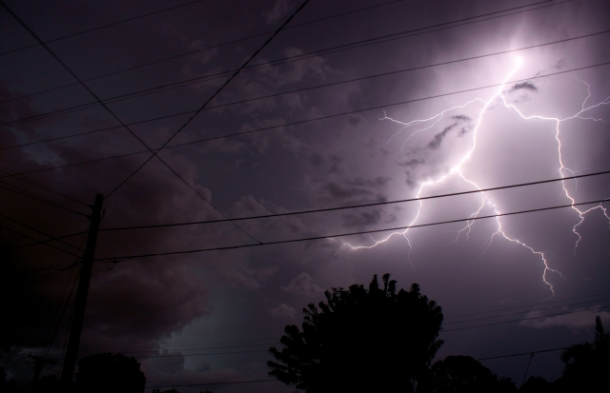
Reliability

Slide 5
What about reliability?
Operational reliability
  Withstand faults, failures, forecasting errors and other regular operational problems
  Operate with a security margin
Resilience
  Withstand natural disasters
  Build a more robust system
Reliability

Slide 6
Cost of reliability
Providing a security margin costs money
  Run additional generating units to have some operating reserve
  Limit production of some generating units to avoid problems in case of a sudden outage
  Build additional generators and transmission lines to improve resilience

Slide 7
Value of reliability
Loss of revenue
Loss of comfort
Measured using surveys
  Estimate of cost of latest outages or
  Willingness to pay extra to avoid outages
Value of Lost Load (VoLL)
  Average value of a MWh not delivered
  Estimates range from $2,400 to $20,000 per MWh
    ~ 100 times larger than the cost of energy

Slide 8
Balancing the greed and the fear

Slide 9
How do we model this balance?
Mathematical optimization problem
  Cost minimization or profit maximization
  Reliability introduced through constraints
    Explicit costing of reliability is still controversial

Slide 10

Environmental impact

Slide 12
Three-way balancing
More complex optimization problems
Some environmental effects can be monetized
  Operating cost of renewable generation is essentially zero
  Carbon tax or carbon trading to reflect the effect of CO₂ emissions
Others cannot be monetized
  Effect of hydro generation on salmon
  Modeled using additional operating constraints

Slide 13
Government energy policy
Not “pure” economics
  Markets and companies take a short term view
  Monopolies → need for regulation
Long term or strategic considerations
  Reduce dependence on imports
Introduction of competitive electricity markets
Choice of primary energy sources
  Promotion of wind and photovoltaic in Germany
  Nuclear power in France
  Energy conservation in the Pacific Northwest

Slide 14
Organization of the electricity supply industry

Slide 15
Traditional electric utility model
Monopoly
  Only supplier of electricity in a given region (“service territory”)
  Consumer does not have a choice of supplier
Vertically integrated
  A single organization performs all the technical and business functions
Generation
Transmission
Distribution
Retail
Consumer

Slide 16
Why vertical integration?
Used to be considered more efficient
Issues:
  Lack of transparency
  Poor internal communication in very large organizations
Generation
Transmission
Distribution
Retail
Consumer

Slide 17
Why vertical integration?
Possible variants:
  Distribution + retail
    Many municipal utilities
    Rural electricity cooperatives
  Generation + transmission
    Bonneville Power Administration
Generation
Transmission
Distribution
Retail
Consumer

Slide 18
Why monopolies?
Building a power system is expensive
Building competing transmission and distribution networks does not make sense
  “Natural Monopoly”
Until recently having several companies “share” a power system was too complicated
Monopoly can be:
  Private (investor-owned utility)
  Public (municipal, utility district, national)
Size of service territories varies

Slide 19
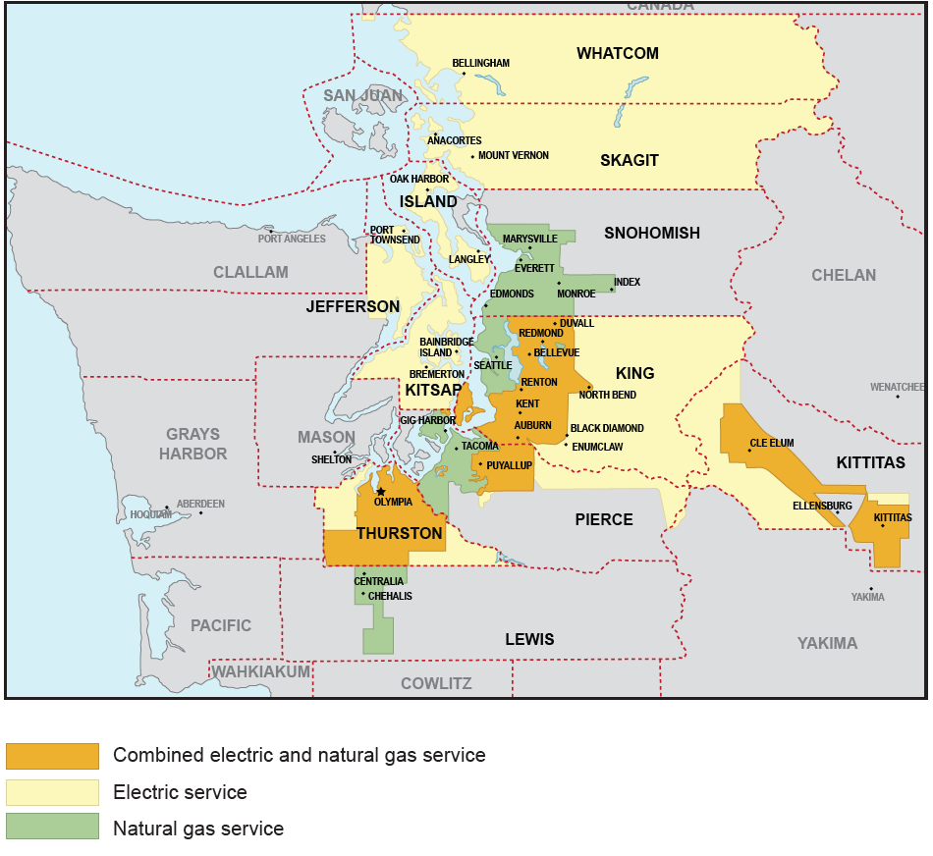
Example 1: Puget Sound Energy
Investor-owned utility
Private monopoly

Slide 20
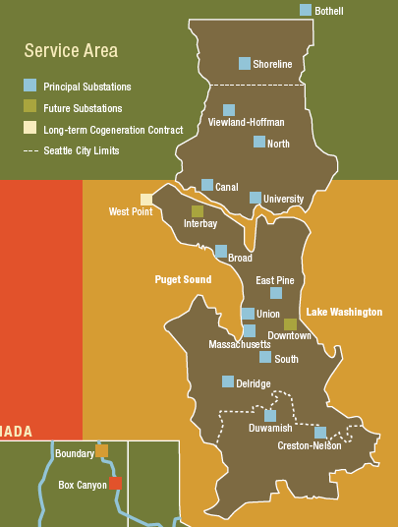
Example 2: Seattle City Light
Owned by the City of Seattle
Public monopoly

Slide 21
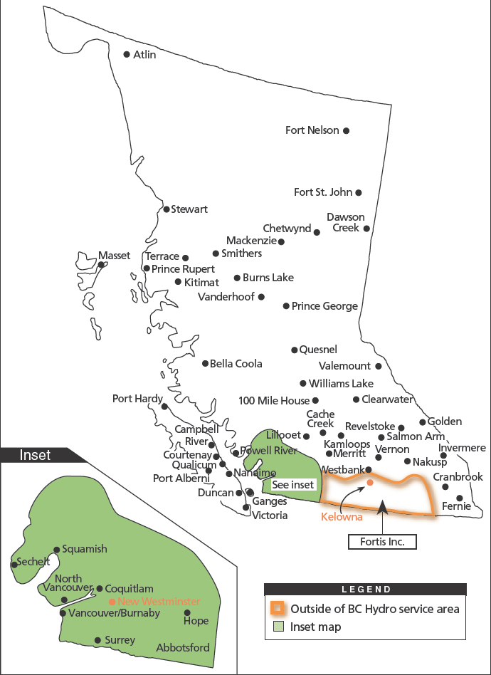
Example 3: BC Hydro
Owned by the Province of British Columbia
Public monopoly

Slide 22
Types of utilities in the United States
Type |  | Number
Investor Owned Companies |  | 265
Municipal Systems |  | 1,818
Public Power Districts |  | 75
State |  | 68
County Systems |  | 5
Rural Electric Co-Ops |  | 922
U.S. Government |  | 37

Slide 23
Regulation
A private monopoly could abuse its position
  It must be regulated by the government
Government-owned utilities operate for the public good
  No need for outside regulation
  Elect new representatives if we are not satisfied

Slide 24
The “Regulatory Compact”
Agreement between an Investor Owned Utility (IOU) and a government
IOU receives the right to be the monopoly supplier over a certain territory
IOU accepts that its rates (i.e. what it can charge consumers) will be determined by a regulator
  Example: Washington Utilities and Transportation Commission

Slide 25
Rate of return regulation
Regulator sets the rates so that the IOU can:
  Recover its operating cost (fuel, personnel, etc…)
  Recover its investment costs (plants, lines, etc…)
  Pay a fair rate of return to its investors
A monopoly utility is a low risk investment
  No competition
  A bankrupt utility is in nobody’s interest
The rate of return can therefore be low compared to other investments

Slide 26
Problems with Private Monopolies
Monopolies are inefficient
  No competition
  No need to be efficient to survive
  No incentive to be efficient:
    Utility earns more if it invests more
    No penalty for building “white elephants”
    High costs passed on to consumers as high prices of electricity
    A bankrupt utility is in nobody’s interest
Rates are “higher than they should be”

Slide 27
Could the regulators do better?
Regulation is difficult
  Little basis for comparison
    Each regulator oversees a small number of utilities
    Each utility has a territory with different characteristics
  Difficult to evaluate the utilities’ decisions
    Regulator does not have as much staff as the utility
    “Information imbalance”

Slide 28
Problems with Public Monopolies
A good government will run its utilities in an efficient and far-sighted manner
This is not always the case
Conflicts can arise between the objectives of the government and the objectives of the utility
Government monopolies are inefficient too!

Slide 29
Things bad governments do…
Keep rates low to please the voters
  Utility does not have enough money for investments
Keep rates high and use the surplus money for other programs
  Inefficient taxation
  Discourage consumption of electricity
Force the utility to make unnecessary investments to create jobs

Slide 30
The “new” electricity supply model
Privatization of public utilities
  Not in the US
  Primarily in Europe and South America
“Unbundling”
  Separate the different functions of the utility
Introduce competition
  Treat electrical energy (MWh) as a commodity
  Create markets for trading this commodity
  Energy transmission and distribution remain services provided by monopoly companies

Slide 31
Expected benefits of privatization
Utility can focus on its mission
If markets function properly:
  Utility gets the revenues it needs
  Price of electricity reflects its true cost
  Optimal allocation of economic resources
Access to private sector capital
  Important in developing countries when government is short of money for investments
Revenue from the sale of privatized assets
  Short term only

Slide 32
Expected benefits of unbundling
Separation between the parts where competition is possible and those where a monopoly is needed:
  Competition between generators
  Monopoly for transmission and distribution
More transparency in the the system
Essential to create a fair market
  An independent system operator will not favor one generator over another

Slide 33
Expected benefits of competition
Introduce competition
Generators become more efficient
Economy benefits
Production cost decreases
Price to consumers decreases
Competitive market

Slide 34
North American Electricity Markets

Slide 35
Market Structures
Vertically integrated utility
Purchasing agency
Wholesale competition
Retail competition

Slide 36
Vertically Integrated Utility
Generation
Transmission
Distribution
Consumer
Consumer
Figure 1.1: Traditional model of electricity supply
Electricity sale
Electricity flow within a company

Slide 37
Vertically Integrated Generation and Transmission
Generation
Transmission
Disco
Disco
Consumer
Consumer
Consumer
Consumer
Figure 1.2: Variant on the traditional model of electricity supply
Electricity sale
Electricity flow within a company

Slide 38
Vertically Integrated Utility
IPP
Generation
IPP
Transmission
Distribution
Consumer
Consumer
Figure 1.3: Incumbent vertically integrated utility with IPPs
Electricity sale
Electricity flow within a company

Slide 39
Genco
Genco
Genco
Wholesale Market
ISO,
TSO,
MO
Disco
Disco
Disco
Large
Consumers
Consumers
Consumers
Consumers
Figure 1.4: Wholesale electricity market structure

Slide 40
Genco
Genco
Genco
Wholesale Market
ISO,
TSO,
MO
Large
Consumers
Retailer
Retailer
Retailer
Retail Market
Discos
Consumer
Consumer
Consumer
Consumer
Figure 1.5: Market with retail competition

Slide 41
(who are the characters in the play)
Dramatis Personae

Slide 42



The old model
The Utility
The Regulator
The Customer
(silent part)
Image: Salvatore Vuono / FreeDigitalPhotos.net

Slide 43
Customer (old model)
Data from National Grid (UK)

Slide 44
Vertically-Integrated Monopoly Utility
Owns and operates all the assets:
  Generating plants
  Transmission network
  Distribution network
  Control centers
Monopoly over a given area

Slide 45
Actors after full unbundling
Generating companies (GENCO)
Distribution companies (DISCO)
Electricity retailers
Market Operators (MO)
Independent System Operator (ISO)
Transmission Companies (TRANSCO)
Consumers
Regulator

Slide 46
Generating companies
Own and operate power generating plants
Compete against each other to sell energy
Competitive advantages:
  More efficient plants
  Cheaper fuel
  Higher plant availability

Slide 47
Distribution Companies
Own and operate the distribution networks
  Regulated business
    Revenues determined by the regulator based on the value of the assets
Monopoly for the sale of electricity in their territory when there is NO retail market

Slide 48
Retailers
Buy electrical energy from generators
Sell electrical energy to consumers
Do not own large physical assets
Often owned by a generator or a distribution company
Competitive advantages:
  Negotiate good price with generators
  Identification of “good” customers
  Efficient billing system

Slide 49
Market Operator
Facilitate trading of electricity
  Matches bids and offers submitted by buyers and sellers of electrical energy
  Runs the market settlement system
    Monitors delivery of energy
    Forwards payments from buyers to sellers
Requirements:
  Fairness, independence
  Efficient technology to support trading
  Efficient settlement of trades

Slide 50
Independent System Operator
Operates the power system
  Maintain load/generation balance
  Responsible for operational reliability
  Operates the market of last resort
Must be independent from other participants to ensure fairness of market
Owns only computing and communication assets
Also known as Regional Transmission Organizations (RTO)

Slide 51
Transmission Companies
Own and maintain transmission assets
  Lines
  Substations
  DC lines
Operate these assets as instructed by the ISO
Regulated business
  Revenues determined by the regulator based on the value of the assets

Slide 52
Transmission System Operator
Combines the functions of
  Independent System Operator
  Transmission Company
Europe has TSOs
North America has ISOs or RTOs

Slide 53
Large Consumers
Industrial or large commercial consumers
May buy directly from the electricity market
May buy electricity at time-varying prices
Can sell “demand response”
  Reduce or shift load in response to price or an incentive

Slide 54
Small Consumers
Residential or commercial consumers
Buy electricity from a retailer or a distribution company
Buy electricity at a fixed price
Too small to sell services directly in electricity market
  Sell demand response through an aggregator

Slide 55
Regulator
Commercial regulation
Technical regulation

Slide 56
Commercial Regulation
Oversees the operation of the electricity market
Determines the allowed revenues of the monopolies (“wire companies”, i.e. transmission and distribution owners)
Government body:
Examples:
  Federal Energy Regulatory Commission (FERC)
    Wholesale markets & transmission
  Washington Utilities and Transportation Commission (WUTC)
    Retail market & distribution

Slide 57
Technical Regulation
Sets the standards for power system reliability and power quality
Enforces these standards
Specialist body:
  North American Reliability Corporation (NERC)
  ENTSO-E (Europe)

Slide 58
Typical re-bundling
Distribution + retail
Generation + transmission network owner
Generation + retail
System operator + market operator
Transmission owner + distribution owner

Slide 59
Perspectives
Old model
  Point of view of the vertically integrated utility is the only one that matters
New model
  Each actor has a different perspective because its motivation is different
    How does it make money?
  Different ways of looking at the same problem

