Slide 1
ns-3 Wi-Fi PHY and coexistence plans
Tom Henderson
Fundamentals of Networking Lab
University of Washington

Slide 2
Acknowledgments
Sumit Roy and students (Ben Cizdziel, Farah Nadeem, Rohan Patidar, Hossein Safavi) have developed link simulations and ns-3 Wi-Fi PHY extensions
ns-3 Wi-Fi Coexistence study conducted in collaboration with CTTC (Nicola Baldo, Biljana Bojovic, Lorenza Giupponi, Marco Miozzo) with funding from Wi-Fi Alliance

Slide 3
Background
ns-3 is an "integrated system simulator" in the taxonomy of IEEE 802.11ax methodology
  As opposed to "link" or "PER simulator" focused on high fidelity PHY modeling
  ns-3 has full-stack models for end-to-end performance assessment
But... current Wi-Fi model has
  limitations in its current PHY abstraction; and
  does not support coexistence

Slide 4
Outline
Describe current and proposed future ns-3 PHY architecture for Wi-Fi evolution and coexistence studies
  Motivation
  LTE/Wi-Fi (LAA) coexistence experience
  Future plans for PHY architecture
  Future plans for alignment with other projects

Slide 5
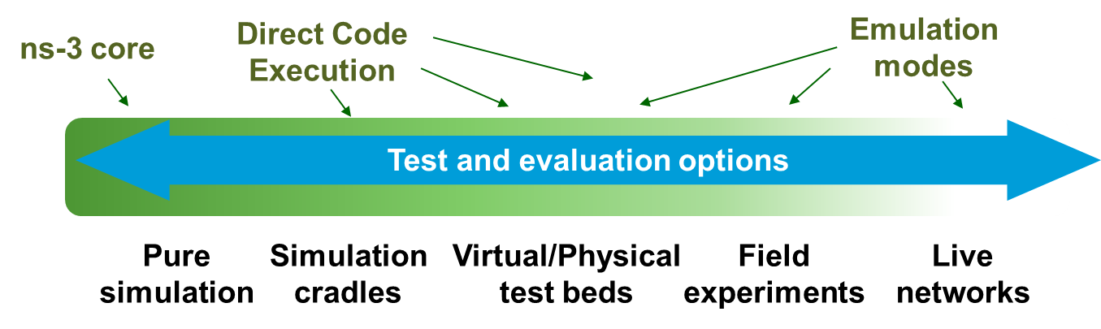
Vision
Modular architecture that supports multiple levels of abstraction
Application
Tcp
Already high fidelity capabilities
Internet
Mac
Phy
Proposed fidelity improvements

Slide 6
Goals
Make ns-3 a freely available, trusted simulator for system evaluations of Wi-Fi evolution and coexistence scenarios
Improvements to the PHY abstraction of the Wi-Fi model
Conformance to IEEE 802.11ax and 3GPP RAN-1 scenarios and methodologies
Alignment with testbeds for validation and improved experimental workflow
Attention to full reproducibility and community validation and extensions

Slide 7
Current ns-3 PHY abstraction
Wi-Fi node
upper layers
After exposing the Packet object to
loss and delay, Packet objects are
copied to every other Phy attached
to the Wifi Channel
Error model objects
probabilistically drop
packets based on the
SINR of the received
packets
MacLow
YansWifiPhy
Wi-Fi node
Wi-Fi node
upper layers
upper layers
MacLow
MacLow
YansWifiPhy
YansWifiChannel
Interference
Helper
ErrorModel
YansWifiPhy
Packet objects are copied to the Wifi Channel object, and associated with a transmit power
The Phy layer uses an
Interference Helper object to track and aggregate interference signals
Propagation Loss and
Delay models

Slide 8
Current PHY limitations
Signals from different technologies cannot coexist
All signals are modelled as flat across the passband (with no frequency decomposition)
Lack of multi-stage reception models
  No support for frame capture effect
  No modeling of preamble success/failure
Error models are presently limited to AWGN channels
Default error models and model for SNR variation within a frame make assumptions of independence, leading to pessimistic error curves
Lack of n/ac features at the PHY (MIMO, Tx beamforming, STBC, LDPC)

Slide 9
Goals
Work initiated in LAA Wi-Fi Coexistence project
Make ns-3 a freely available, trusted simulator for system evaluations of Wi-Fi evolution and coexistence scenarios
Improvements to the PHY abstraction of the Wi-Fi model
Conformance to IEEE 802.11ax and 3GPP RAN-1 scenarios and methodologies
Alignment with testbeds for validation and improved experimental workflow
Attention to full reproducibility and community validation and extensions

Slide 10
LAA Wi-Fi Coexistence project
To support coexistence studies on an openly available platform, Wi-Fi Alliance funded a joint University of Washington/CTTC project to extend ns-3
Methodology defined in 3GPP Technical Report TR36.889, but with an eye towards 802.11ax also
Enhancements needed:
  Wireless models (LBT access manager, SpectrumWifiPhy, propagation/fading models)
  Scenario support (traffic models)
  Output data gathering and processing

Slide 11
Indoor 3GPP scenario
Figure adapted from TR36.889

Slide 12
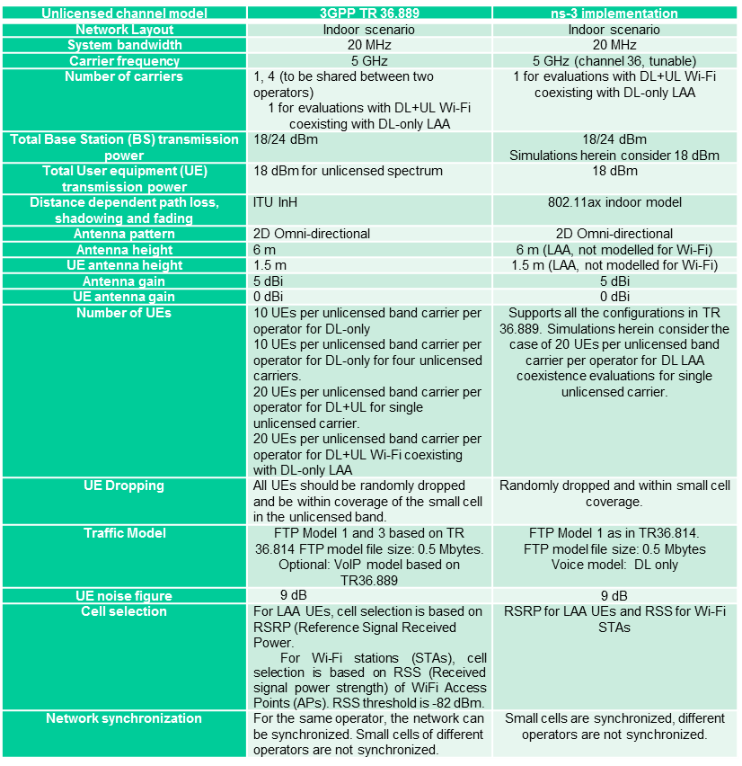
Indoor scenario details
Parameter
TR36.889
ns-3
Alignment, where
possible, with
TR36.889 scenario
details

Slide 13
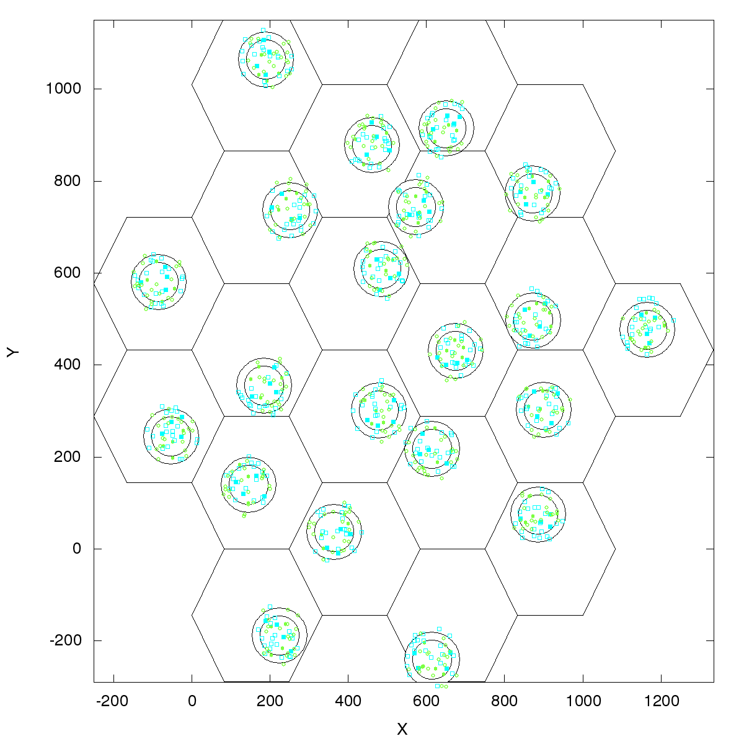
Outdoor scenario details
Outdoor layout: hexagonal macrocell layout. 7 macro sites and 3 cells per site. 1 Cluster per cell. 4 small cells per operator per cluster, uniformly dropped. ITU UMi channel model.
Figure source: 3GPP TR 36.889 V13.0.0 (2015-05)

Slide 14
A spectrum-aware PHY abstraction
SpectrumPhy (Baldo, Miozzo*) was first introduced with the addition of LTE in ns-3, and has since become standard, with the exception of Wi-Fi
Uses a power spectral density representation of signals
  Adjustable granularity at the time a transmitter/receiver is implemented
  Multi-model channel converts between signal formats (i.e. various granularities used by different wireless systems e.g. LTE and Wi-Fi)
  Possibility to implement frequency selective channels and propagation models
* N. Baldo and M.Miozzo, "Spectrum-aware Channel and PHY layer modeling for ns3,"
ICST VALUETOOLS 2009.

Slide 15
Spectrum Module
Dev 1
(SpectrumPhy)
Dev 2
(SpectrumPhy)
Dev N
(SpectrumPhy)
SpectrumValue
SpectrumValue
SpectrumValue
SpectrumChannel
Three key pieces
  SpectrumValue, SpectrumChannel, SpectrumPhy
SpectrumValue is the signal abstraction being passed through to the channel (and to the users)
  A vector of sub-bands representing center frequency, bandwidth, and sub-band power specral density
SpectrumChannel delays/attenuates/modifies the transmitted signal as specified before providing copies to all receivers
  Automatically converts signals with different resolutions
Inheriting from SpectrumPhy allows different types of devices to
interact through the wireless channel

Slide 16
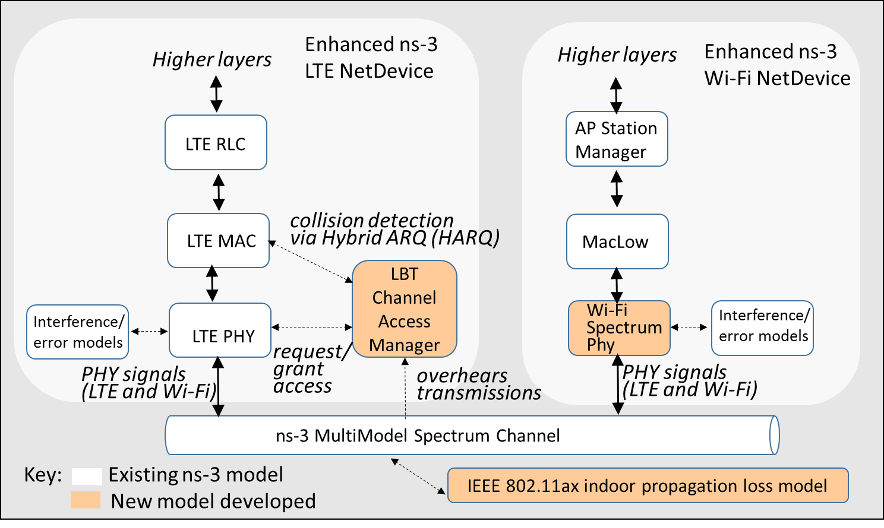
Overview of ns-3 extensions

Slide 17
Additional Wi-Fi and LTE extensions
Wi-Fi:
preamble detection based on AWGN and TGn Channel Model D
RSS-based AP selection and roaming
MIMO approximations to support 2x2 DL, 1x2 DL on AWGN and TGn Model D
Ideal rate control similar to 802.11n fast link adaptation
LTE:
Interference model enhanced to handle interference by signals of any type, rather than assuming synchronized interference.from LTE only

Slide 18
Sample results
Driven by a scripting framework (runner and plotter scripts) for parametric exploration

Slide 19
For more information
ns-3 Wiki page:
  https://www.nsnam.org/wiki/LAA-WiFi-Coexistence
    module documentation
    references to various publications
    documentation on reproducing results
Code (not yet ns-3 mainline):
  http://code.nsnam.org/laa/ns-3-lbt

Slide 20
Goals
Work initiated in LAA Wi-Fi Coexistence project
Work planned for future efforts
Make ns-3 a freely available, trusted simulator for system evaluations of Wi-Fi evolution and coexistence scenarios
Improvements to the PHY abstraction of the Wi-Fi model
Conformance to IEEE 802.11ax and 3GPP RAN-1 scenarios and methodologies
Alignment with testbeds for validation and improved experimental workflow
Attention to full reproducibility and community validation and extensions

Slide 21
Proposed eventual ns-3 PHY abstraction
Frame synchronization and
capture effect modelled

Slide 22
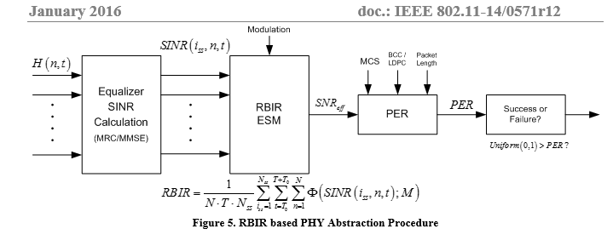
Link-to-system mapping
Propose to follow the PHY Abstraction methodology defined in Appendix 1 of the "11ax Evaluation Methodology"
  Calculate effective average SINR in each OFDM symbol
  Map from AWGN PER to multipath channel PER by using a Received Bit Mutual Information Rate (RBIR) mapping function
  Provide ns-3 with AWGN PER models and mapping functions for each MCS and each coding scheme, for different packet lengths

Slide 23
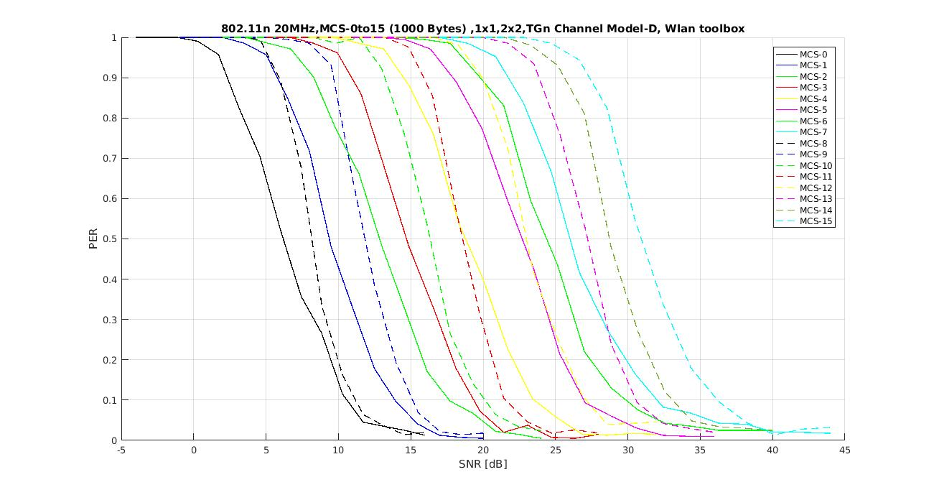
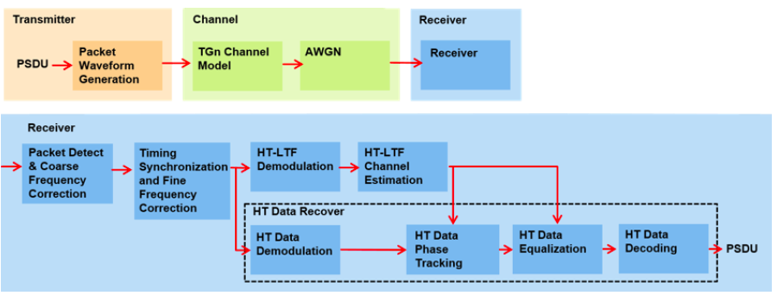
MATLAB WLAN System Toolbox
UW FuNLAB transitioning from custom link simulator (developed by Safavi) to WLAN System Toolbox
Data provided by
R. Patidar

Slide 24
Testbed and research hardware alignment
Where possible, seek alignment between research testbeds/hardware and ns-3 scenarios
Commonality or reuse of experimental control frameworks
Use of testbeds/hardware for validation where possible
Rutgers WINLAB ORBIT (past*); Utah's PhantomNet, OAI, others...(planned)
* https://www.nsnam.org/wiki/HOWTO_use_ns-3_directly_on_the_ORBIT_testbed_hardware

Slide 25
Status
SpectrumWifiPhy and Wi-Fi related extensions for coexistence planned for ns-3.26 (July)
LTE Carrier Aggregation (enabling cross-carrier scheduling) to be added by CTTC by fall timeframe
Framework for incorporating link simulations, and basic OFDM models aligned with TGn/ac, to be added
Full 3GPP coexistence methodology support in mainline releases requires additional integration work
Other open source contributions (e.g. frame capture models from WINLAB) need review and integration

Slide 26
Summary
Make ns-3 a free, open source, and trusted simulator for system evaluations of Wi-Fi evolution and coexistence scenarios
Improve the PHY abstraction of the Wi-Fi model
Conformance to IEEE 802.11ax and 3GPP RAN-1 scenarios and methodologies
Testbed alignment for validation and improved experimental workflow
Full reproducibility and community validation and extensions

