Slide 1
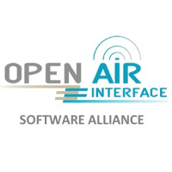






























Opening 5G
Prof. R. Knopp
Communication Systems Dept.
EURECOM, Sophia Antipolis FRANCE

Slide 2
Overview
Challenges for Open-source technologies at the onset of 5G standardization
OAI Software Alliance Objectives
Avenues for performance evaluation

Slide 3
Open-Source, Telcos and 5G
Open-source technologies are everywhere at the extremities of envisaged 5G telecom equipment
  Slicing and softwarisation are among the most important aspects of 5G networking architecture.
    end-to-end agile, dynamic, on-demand resource mobility optimization
    management via the use of SDN and NFV.
  Focus of open-source movements is really on tools for orchestration and control
    ONOS, OPNFV, OSM, etc.
  Other main area: testing of telecom software in data center environments
    Software emulators of radio network components in data center (i.e. connection of software stubs at various points in telco network inside the RAN/MEC data center)
    => next generation wireless performance evaluation tools! Because of chosen computing environment, simulator/emulator targets and real communications equipment are getting closer.
OpenAirInterface => bring open-source into the radio-access network
  And provide licensing which is compatible with 3GPP

Slide 4
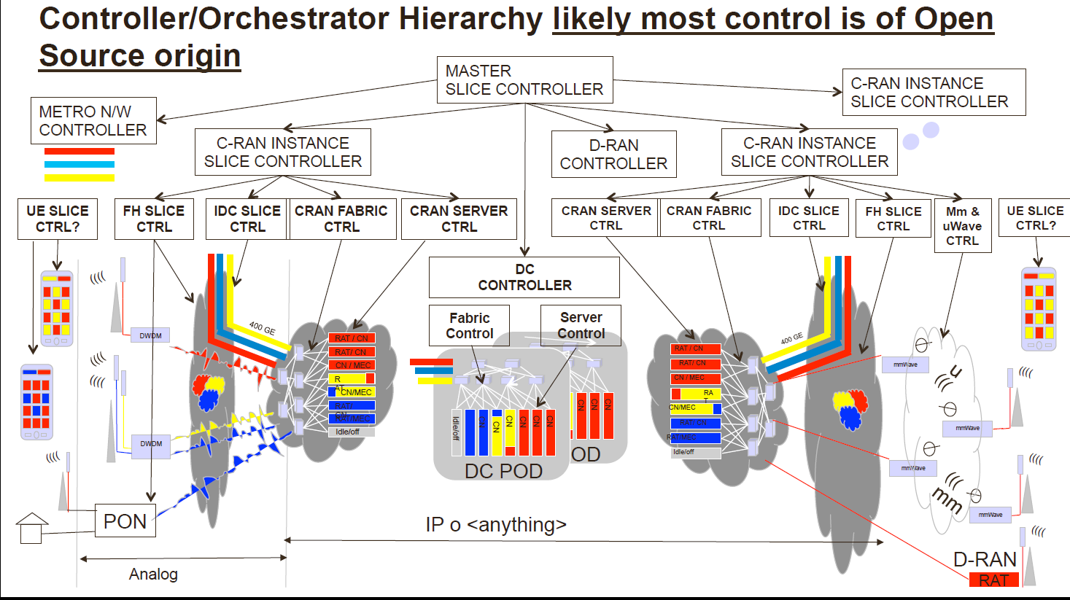
5G Network Big Picture (ITU IMT2020 FG)
Source: https://www.itu.int/en/ITU-T/Workshops-and-Seminars/itu-ngmn/Documents/Abstracts_and_Presentations/Peter-Ashwood-Smithv2.pdf

Slide 5
Another vision of 5G (protocol splits)
5G CORE
Heterogeneous PDCP
“RAN” Cloud
LTE-RLC
LTE-MAC
LTE-PHY
5G-RLC
5G-MAC
5G-PHY
Higher-Latency Front-haul
split
Low-Latency Front-haul
split
5G-RLC
5G-MAC
5G-PHY
LTE-RLC
LTE-MAC
LTE-PHY
WIFI
MAC
WIFI
PHY
LTE-PHY
Radio
5G-PHY
Radio

Slide 6
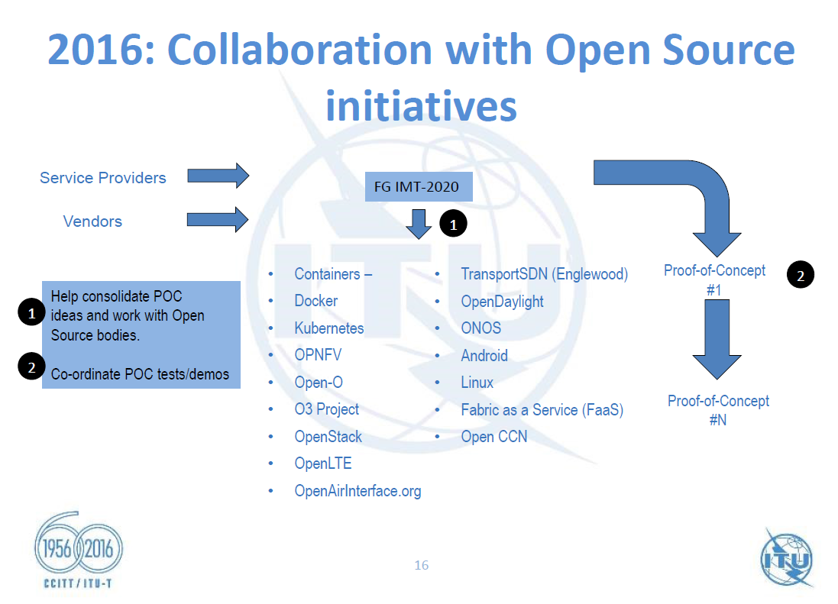
ITU-Vision for Open-source and 5G
Source: http://www.itu.int/en/ITU-T/wtsa16/prepmeet/Documents/CIS-RCC/presentations/Presentation_1_Forum_ITU-Vision%202020.pdf

Slide 7
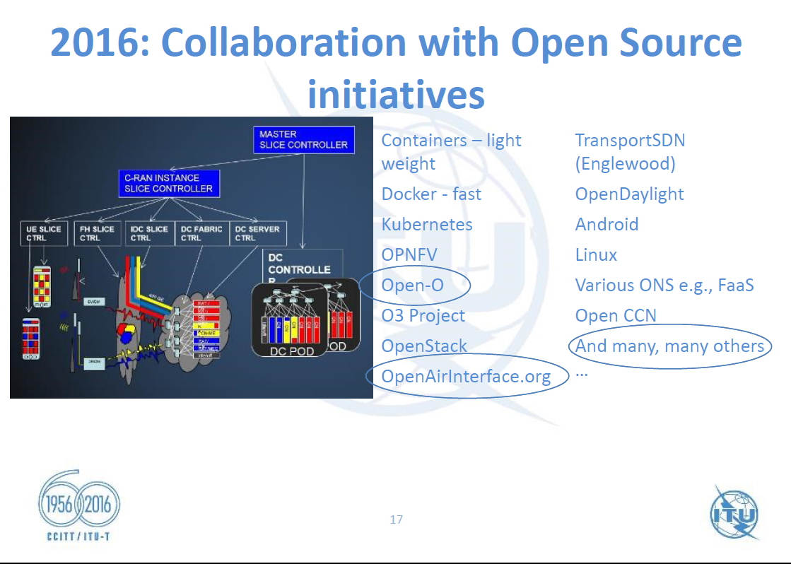
ITU-Vision for Open-source and 5G
Source: https://www.itu.int/net4/wsis/forum/2016/Content/AgendaFiles/document/6d79fff5-b348-4f95-b7e8-e940c9d34dfc/ITU-TSB_Bilel_Jamoussi.pdf

Slide 8
A bit on OpenAirInterface.org
Today it is feasible to put a fully-compliant 4G eNodeB and EPC in a commodity x86 or ARM-based computer (or data center for a pool of eNodeBs) and UE too.
  Emergence of “radio”-hackers in addition to commercial vendors
  OAI Alliance
    launched in 2014
    3GPP strategic members in 2015 (Bell Labs, Orange, TCL-Alcatel, Ercom)
Coupling this with an open-source community makes for a very disruptive technology for the onset of 5G
  What we’re building
    Community of individuals, academics, small companies and major industrials embracing open-source for 5G
  What we hope to become
    A strong voice and maybe a game-changer in the 3GPP world
      Real impact from “the little guys” on 3GPP systems

Slide 9














Main Challenge in bringing open-source into the RAN
  Licensing for 3GPP/WIFI OS communities
    Allow 3GPP members to contribute to open-source and still perceive royalties
    Compatible with
      academic/research/prototyping use
      commercial use in devices, data centers and testing equipment
    Approval by Alcatel-Lucent, Orange, TCL and Ericsson (observer)
  Community coexistence/synergy with standardization process
    Use of open-source in prototyping phase of 5G
    Open-source community following 3GPP process
    Community representation in 3GPP via OSA
Main CLOUD
EPC + ClearWater IMS, FreePCRF (OpenStack + JuJu)
S1AP
GTPu
S1AP
GTPu
S1AP
GTPu
eNB
eNB
eNB
Mobile Edge Cloud
openLTE
UE

Slide 10
A bit more on licensing
We would like a community made up of academics, small and medium enterprises and major telecom industry
  Work in parallel to 3GPP, but independently of the standardization process
  3GPP documents are open to non-members during the study and work period
  Hopefully academics can influence the standard through open-source prototyping
Main issue: patent licensing
  GPL and Apache are not compatible with standards (at least not anytime soon)
  Contributors with standards-essential patents should be able to claim royalties on their intellectual property
  3GPP uses so-called FRAND licensing for the standard itself and this is automatically (legally) associated to any implementation of the standard.
We (OpenAirInterface) get a lot of heat from traditional open-source developers, but this is the right choice if you want to influence the standard (5G and beyond) and work with the main players.
Big industry (e.g. Ericsson, Qualcomm, etc.) approve this type of licensing for open-source, we just have to convince them to start contributing …

Slide 11
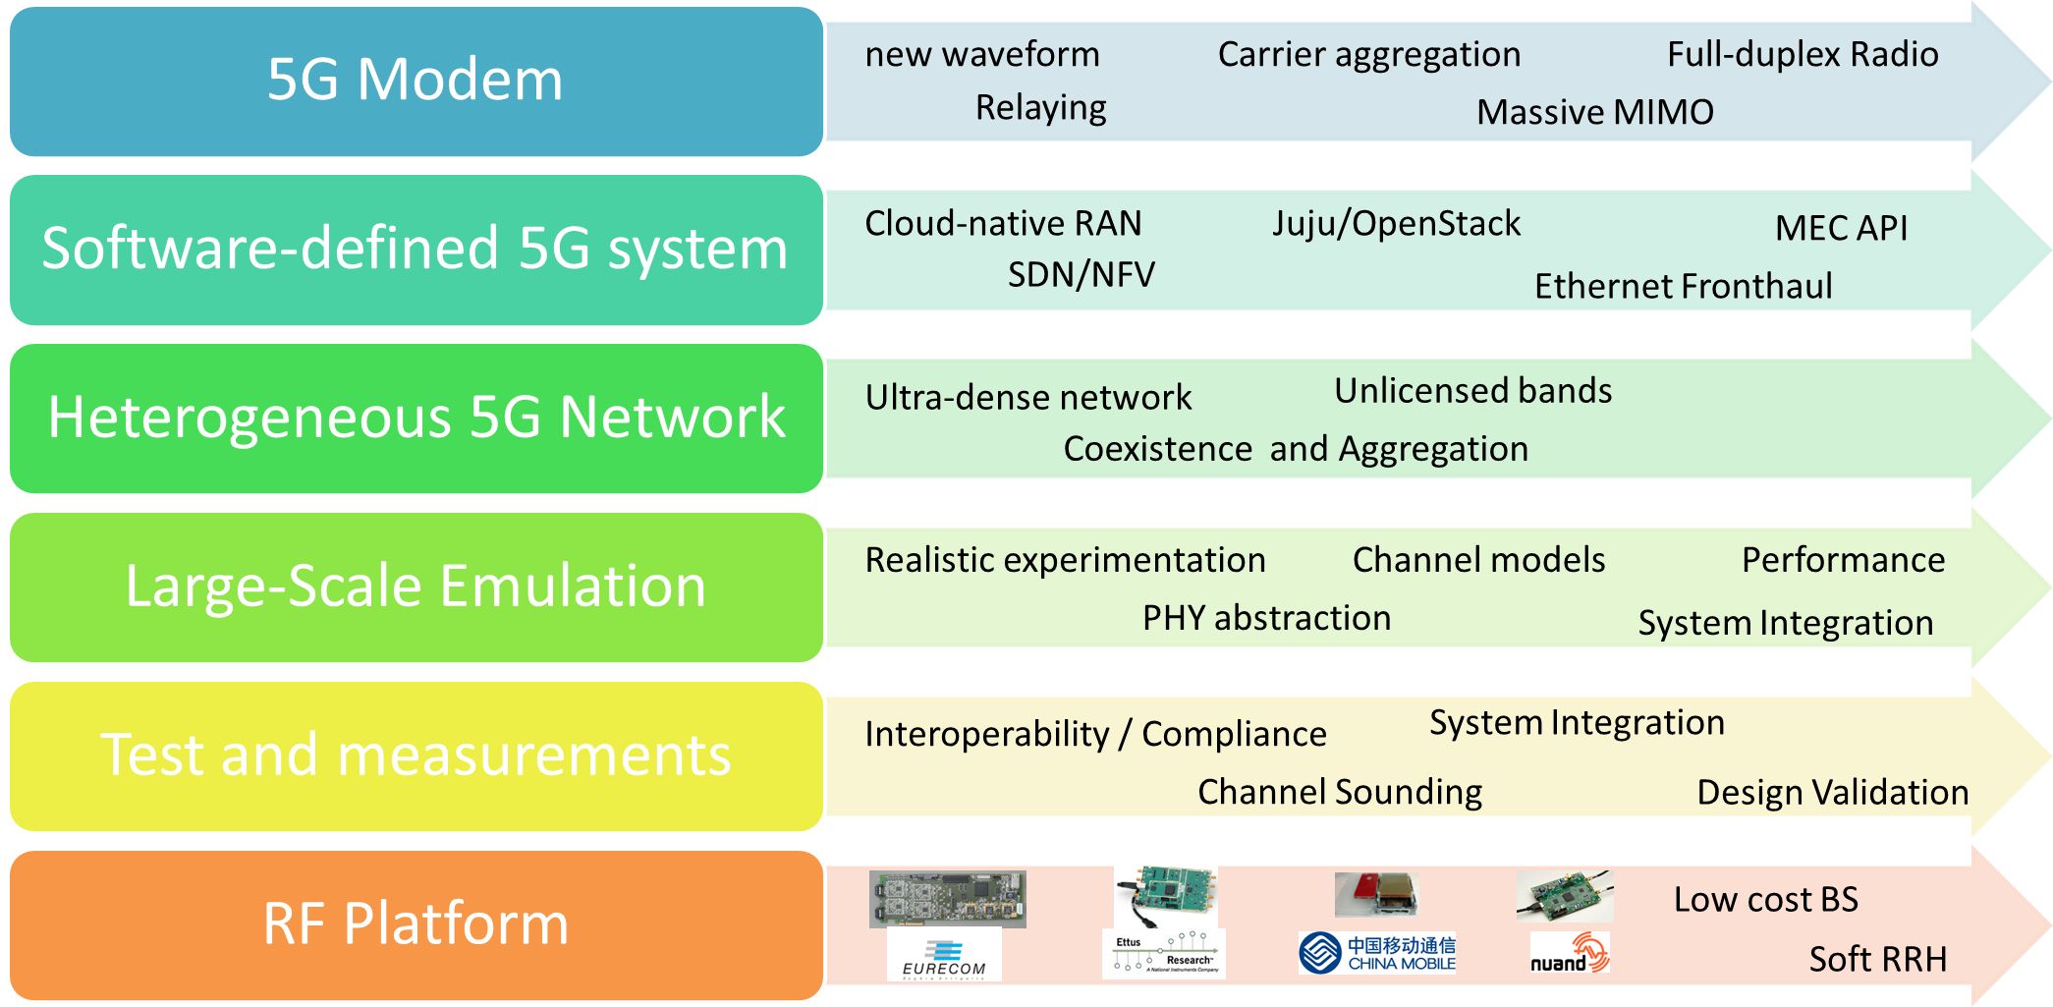
OSA Strategic Areas
Various use cases are considered, namely MTC/IoT, RAN Sharing, moving cells, etc.

Slide 12


RRH to Datacenter Architecture
(Deployment @ EURECOM)
Some issues
Distributed computation
Cheap synchronization
Loosening of control/user-plane coupling
Real-time I/Q over Eth links (copper, low-cost fiber)
Main CLOUD
(Legacy Services)
openairCN EPC + ClearWater IMS, FreePCRF (OpenStack + JuJu)
S1AP
GTPu
S1AP
GTPu
S1AP
GTPu
Small-cell
RRH
L1L
Atomic
Clock
1 or 10GBe
eNB
eNB
eNB
Small-cell
RRH
L1L
Small-cell
RRH
L1L
LOCAL CLOUD
(Low-latency Services)
CPRI
macro-cell
RRH
L1L
CPRI
GW

Slide 13
UE prototyping
Led by TCL
  Teams in France, Hong Kong and Shanghai working with OAI
Target
  Stability of current 4G OAI UE
    Interoperability with commercial eNodeB (Cat 6)
  5G UE prototypes for 2018
    100 MHz bandwidth
    New waveforms (UF-OFDM)
    4x4 MIMO
  NB-IoT prototypes for 2017

Slide 14
Avenues for Performance Evaluation
A mock yet realistic data-center environment is reasonably simple to deploy in a university (much more so than a full radio network in the spirit of the ITU IMT-2020 Vision)
  Combine radio elements and real end-user devices with synthetic (real-time) networks
  Several companies develop eNodeB testers (e.g. Ercom, Aeroflex)
  Labs that can’t afford equipment like this can make scaled down versions using OAI
  Both would need
    adaptions for data center RAN (fronthaul interfaces)
    accurate and high-performance channel, mobility and traffic models (much can be inherited from ns3 community)
    Software for performance measurements: real-time tracing
  Exploit open-source communities (e.g. ONOS, OPNFV, etc.) for NFV, SDN, etc.
We should all get in a collaborate with telecom industry, they are opening up and we should help

Slide 15
What is still needed
Stability and scalability of OAI implementation
  Community is helping a lot here recently but we need more direct input from academic groups in the USA.
  Alliance projects are set up to ensure this, but we need manpower
Integration of available open-source tools for performance evaluation
  Licensing could be delicate (GPL is incompatible, could still be socket-based …)
Testing methodology (continuous integration)
  Simple testing sites set up for community use at EURECOM and more recently INRIA (R2Lab in Sophia Antipolis)
  We will need more in the USA if the number of developers increases here
Replication of full network infrastructure at multiple sites
  Europe will be covered by us and other partners
  Discussions underway with Chinese, Taiwanese and Japanese institutions
  Underway in India (IIT Hyderabad)
  USA?

Slide 16
Next Steps for OAI and the OSA (general)
Ensure a path 4G → 5G through open-source policy Reference implementation of Rel 14 → 5G
    Fronthaul technology, low-cost high-efficiency
    new carrier candidates now (e.g. UF-OFDM, NB-IoT), short packet low-latency carriers, contention-based access
    VRAN, NFV, MEC architectures
Serious contributors from outside Eurecom
  Combination of hackers, academics, SMEs and major industry
« ready to use » for anybody on commodity hardware (PCs + National Instruments)
  and industrial platforms !
    Functional with RU/SU split IF3 (interconnection with CPRI RRH)
  EURECOM ExpressMIMO2, NI/Ettus USRP, Nuand BladeRF, Lime SoDeRa
Multi-architecture
  x86, ARM, soon NXP (Freescale)

Slide 17
Conclusions
OAI is ramping up very quickly now and 5G will need an open-source community for the RAN portion
  Proof-of-concept demonstrators
  Collaboration with standards making bodies
OAI needs a developer base in the USA (users are here, no real development yet)
  Connection with US industry labs should be done here
    Support, contribution to OAI Alliance projects
  Need funding for US university labs to work on OAI
    Continued collaboration with European initiatives (e.g. FIRE+)
  Need to set up periodic workshops here too
    1st workshop/training in May 2016 was a success, but there were very few non-European labs.

